Slide 1
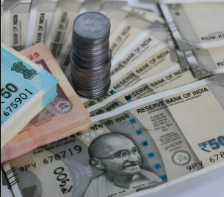

Fake Currency Detection
PROJECT EXHIBITION – 01
SUPERVISED BY: DR SUBASH CHANDRA BOSE I REVIEWED BY: DR NILAMADHAB MISHRA , DR SHIV SHANKAR PRASAD SHUKLA

Slide 2

TEAM MEMBERS
Shubhankar Pandey (23BAI11053)
Meera Singh (23BAI11317)
Tithi Semwal (23BAI10920)
Jaison Jai John (23BAI11378)
Anshuman Pandey(23BAI10208)
PROJECT EXHIBITION – 01
SUPERVISED BY: DR SUBASH CHANDRA BOSE I REVIEWED BY: DR NILAMADHAB MISHRA , DR SHIV SHANKAR PRASAD SHUKLA

Slide 3
Problem Statement
Money drives economic activities like manufacturing, circulation and consumption, making it essential in today's society.
However, counterfeit currency is a growing threat, harming everyday people and shrinking the economy.
Counterfeit notes, especially in Rs. 500 and Rs. 1,000 denominations, are hard to detect, affecting transactions at every level. Globally, the issue is a concern.
In India, fraud cost banks Rs. 16,789 crores in one year, and counterfeit notes have surged, with a significant rise reported in Rs. 500 (101.9%) and Rs. 2,000 (54.6%) notes, according to the RBI's 2021–22 report.
PROJECT EXHIBITION – 01
SUPERVISED BY: DR SUBASH CHANDRA BOSE I REVIEWED BY: DR NILAMADHAB MISHRA , DR SHIV SHANKAR PRASAD SHUKLA

Slide 4
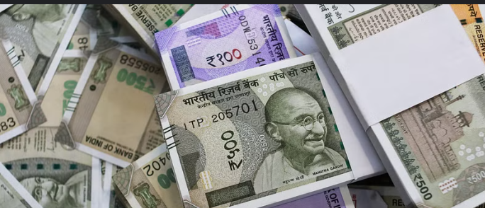
Our Agenda
Improve Detection Efficiency: By leveraging advanced image processing techniques to quickly identify counterfeit currency with high accuracy.
Support Real-Time Verification: By analyzing key features such as security threads, watermarks, and note patterns for instant detection of fake notes.
Enhance User Accessibility: By providing a user-friendly interface for seamless implementation in banks, businesses, and daily transactions.
PROJECT EXHIBITION – 01
SUPERVISED BY: DR SUBASH CHANDRA BOSE I REVIEWED BY: DR NILAMADHAB MISHRA , DR SHIV SHANKAR PRASAD SHUKLA

Slide 5

NOVELTY
The Fake Indian Currency Detection system introduces a novel approach by leveraging advanced deep learning and computer vision techniques to analyze intricate features of currency notes, such as watermarks, security threads, and micro-lettering, beyond traditional methods. The system offers real-time detection capabilities, ensuring immediate identification of counterfeit notes with high accuracy. This innovative solution not only improves operational efficiency but also strengthens the fight against counterfeit currency circulation.
PROJECT EXHIBITION – 01
SUPERVISED BY: DR SUBASH CHANDRA BOSE I REVIEWED BY: DR NILAMADHAB MISHRA , DR SHIV SHANKAR PRASAD SHUKLA

Slide 6
LITERATURE REVIEW
Author | Title | Description
Devid Kumar, Surendra Singh Chauhan | A STUDY ON INDIAN FAKE CURRENCY DETECTION | The detection of fake Indian currency has progressed significantly with the integration of image processing and machine learning techniques. Traditional manual methods, though widely used, are time-consuming and error-prone. Advanced approaches such as feature extraction, edge detection, and classification algorithms like Support Vector Machines (SVM) and Convolutional Neural Networks (CNN) analyze security features like watermarks, security threads, and micro-lettering. Real-time mobile applications using computer vision provide accessibility and accuracy, helping individuals and businesses detect counterfeit notes efficiently.
Aneena Babu, Vineetha Shankar P | Fake Indian Currency Detection | This paper enhances Counterfeit currency detection employs image processing techniques, machine learning, and hybrid models to identify fake notes effectively. Approaches like ORB, SSIM, and deep learning enhance accuracy. Challenges include dataset limitations, real-time processing, and evolving counterfeiting methods. Future research emphasizes advanced algorithms, blockchain integration, and global collaboration to combat counterfeiting effectively.
PROJECT EXHIBITION – 01
SUPERVISED BY: DR SUBASH CHANDRA BOSE I REVIEWED BY: DR NILAMADHAB MISHRA , DR SHIV SHANKAR PRASAD SHUKLA

Slide 7
Project Timeline
Week 01- 04
Project Planning
And literature Review
And
Dataset Collection
Week 05-08
Dataset Preprocessing
And model development (Software Level)
Week 09-12
Model Evaluation and improvement and
Implementing ESP 32 CAMERA
PROJECT EXHIBITION – 01
SUPERVISED BY: DR SUBASH CHANDRA BOSE I REVIEWED BY: DR NILAMADHAB MISHRA , DR SHIV SHANKAR PRASAD SHUKLA

Slide 8
What is Counterfeiting?
Counterfeiting is the act of creating fake or imitation items with the intent to deceive others into believing they are genuine. Common examples include counterfeit currency, goods, documents, and trademarks. Counterfeiting undermines economic stability, intellectual property rights, and public trust, often causing financial and reputational harm.
PROJECT EXHIBITION – 01
SUPERVISED BY: DR SUBASH CHANDRA BOSE I REVIEWED BY: DR NILAMADHAB MISHRA , DR SHIV SHANKAR PRASAD SHUKLA

Slide 9
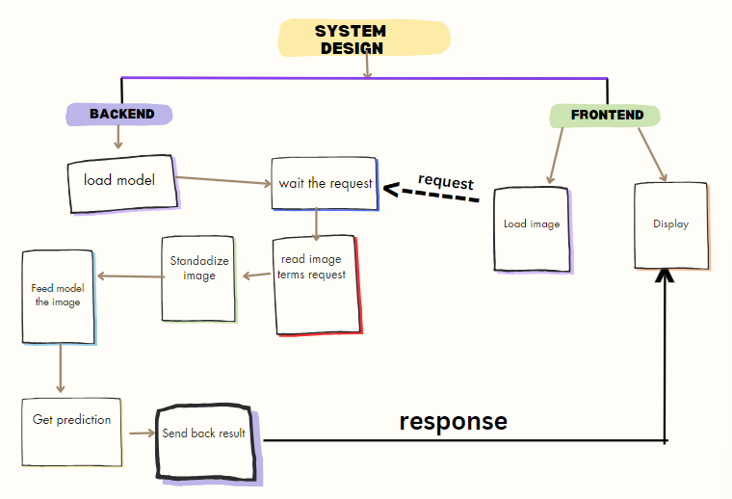
Architecture Design
PROJECT EXHIBITION – 01
SUPERVISED BY: DR SUBASH CHANDRA BOSE I REVIEWED BY: DR NILAMADHAB MISHRA , DR SHIV SHANKAR PRASAD SHUKLA

Slide 10


About our dataset
This Dataset consists of Indian Currency image which is having two category i.e. real and fake. The image have been augmented by rotation and sharpening to produce significant amounts of images.
The dataset contains total 5426 images, with each image having an average resolution 500 X 500 pixels. These images are in JPEG And PNG format. The dataset divided into three subset:
Training set – 3797 images (Real and Fake)
Testing set – 1085 images (Real and Fake)
Validation Set – 544 images (Real and fake)
Dataset is categorized into 2 Classes- Real and Fake
PROJECT EXHIBITION – 01
SUPERVISED BY: DR SUBASH CHANDRA BOSE I REVIEWED BY: DR NILAMADHAB MISHRA , DR SHIV SHANKAR PRASAD SHUKLA

Slide 11
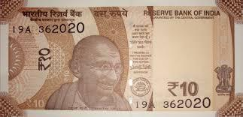
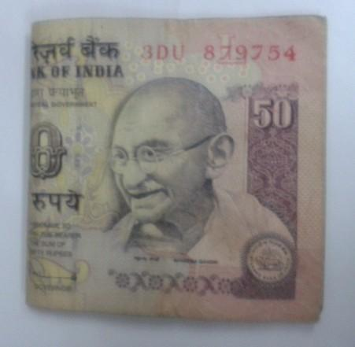
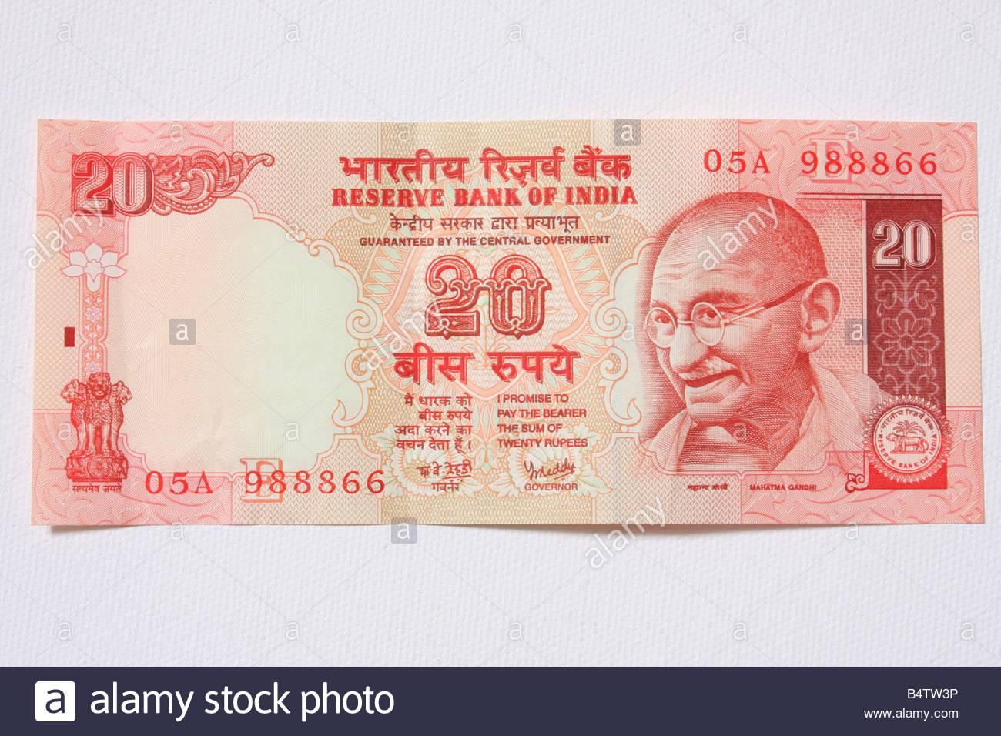
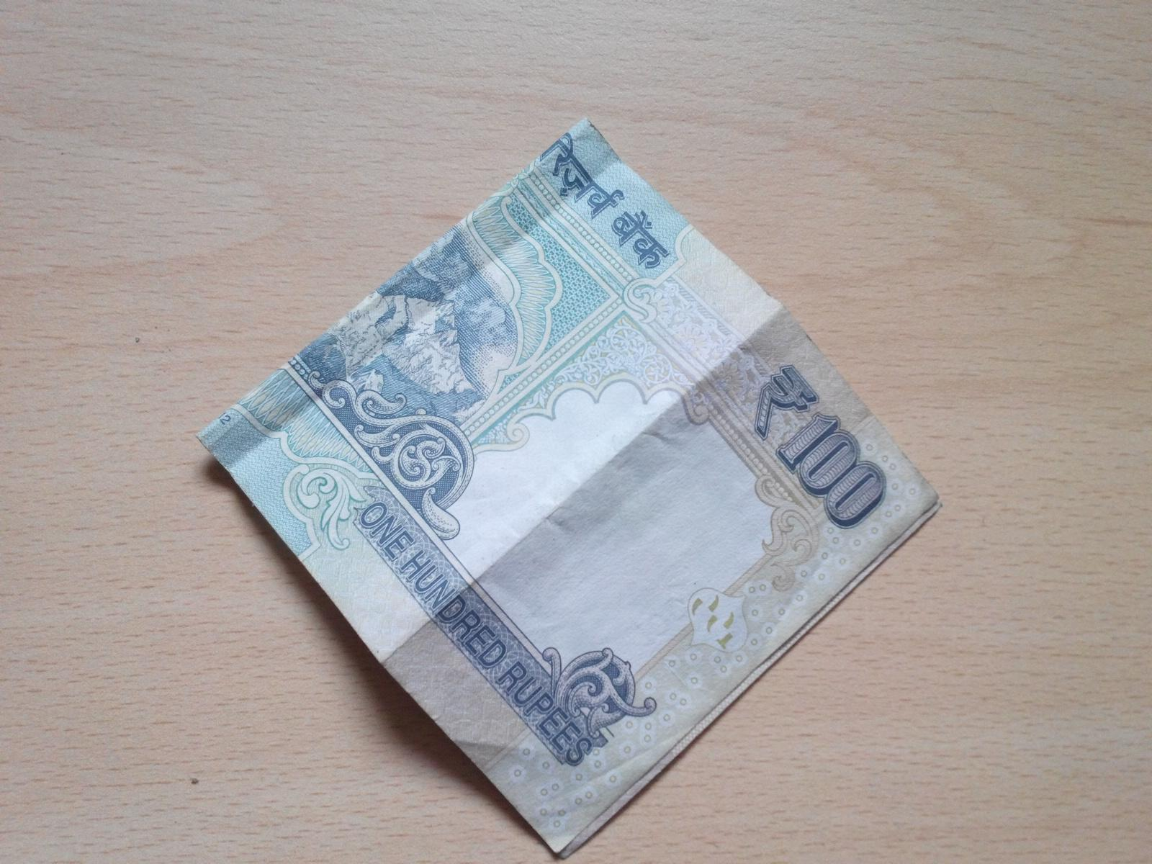
Some Pictures from Dataset (Real)
PROJECT EXHIBITION – 01
SUPERVISED BY: DR SUBASH CHANDRA BOSE I REVIEWED BY: DR NILAMADHAB MISHRA , DR SHIV SHANKAR PRASAD SHUKLA

Slide 12
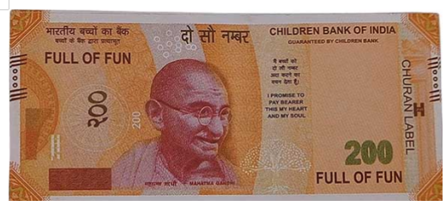
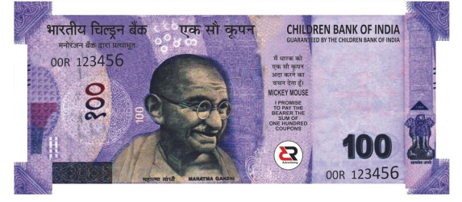
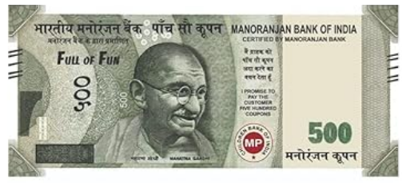
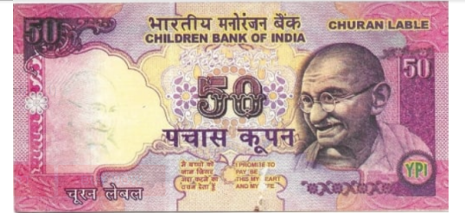
Some Pictures from Dataset (Fake)
PROJECT EXHIBITION – 01
SUPERVISED BY: DR SUBASH CHANDRA BOSE I REVIEWED BY: DR NILAMADHAB MISHRA , DR SHIV SHANKAR PRASAD SHUKLA

Slide 13
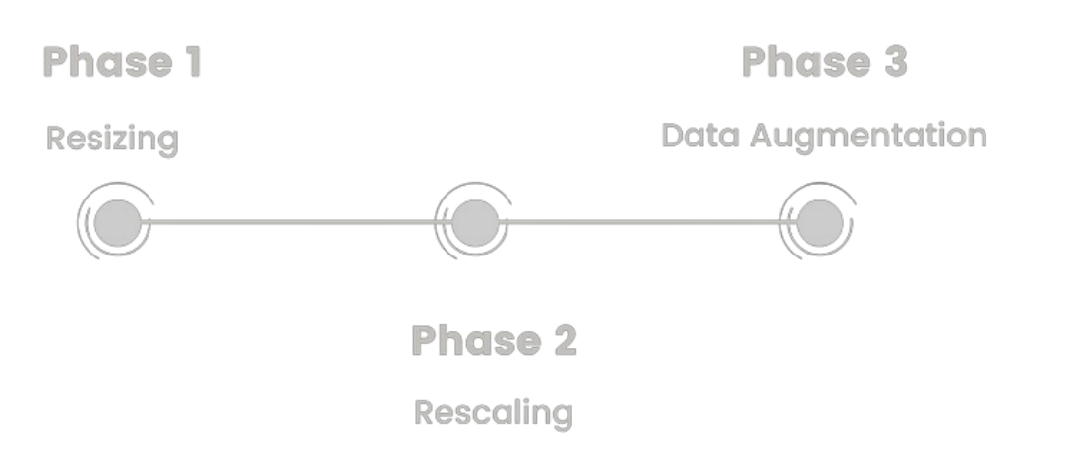
Image preprocessing
rescale=1.0 / 255,
rotation_range=20,
width_shift_range=0.15,
height_shift_range=0.15,
shear_range=0.2,
zoom_range=0.2,
horizontal_flip=True,
brightness_range=[0.9, 1.1]
PROJECT EXHIBITION – 01
SUPERVISED BY: DR SUBASH CHANDRA BOSE I REVIEWED BY: DR NILAMADHAB MISHRA , DR SHIV SHANKAR PRASAD SHUKLA

Slide 14
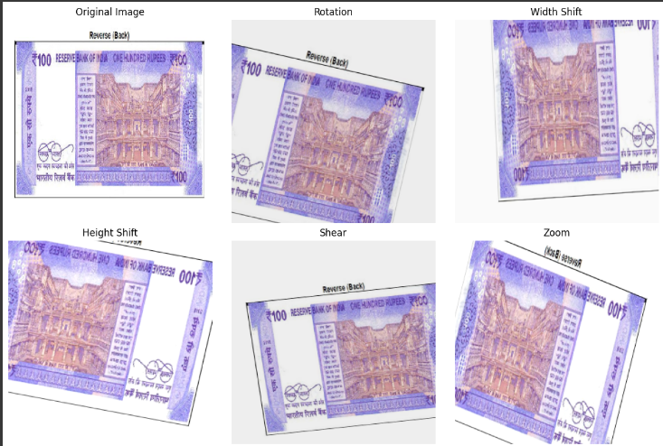
Image preprocessing
PROJECT EXHIBITION – 01
SUPERVISED BY: DR SUBASH CHANDRA BOSE I REVIEWED BY: DR NILAMADHAB MISHRA , DR SHIV SHANKAR PRASAD SHUKLA

Slide 15
Model
Building
PROJECT EXHIBITION – 01
SUPERVISED BY: DR SUBASH CHANDRA BOSE I REVIEWED BY: DR NILAMADHAB MISHRA , DR SHIV SHANKAR PRASAD SHUKLA

Slide 16

Our Model – Cnn model(Xception model)
PROJECT EXHIBITION – 01
SUPERVISED BY: DR SUBASH CHANDRA BOSE I REVIEWED BY: DR NILAMADHAB MISHRA , DR SHIV SHANKAR PRASAD SHUKLA

Slide 17
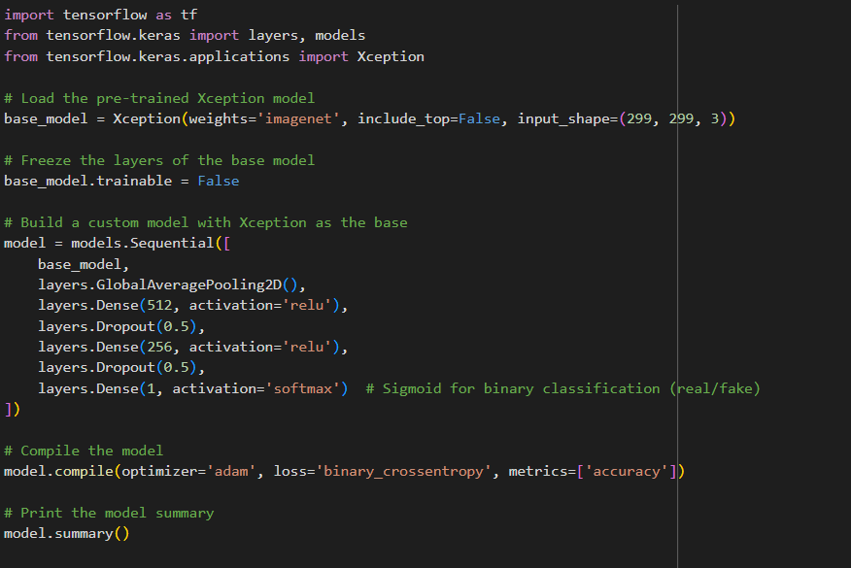
PROJECT EXHIBITION – 01
SUPERVISED BY: DR SUBASH CHANDRA BOSE I REVIEWED BY: DR NILAMADHAB MISHRA , DR SHIV SHANKAR PRASAD SHUKLA

Slide 18

GlobalAveragePooling2D Layer
Dense Layer
Block_sepconv layer
Batch_normalization
PROJECT EXHIBITION – 01
SUPERVISED BY: DR SUBASH CHANDRA BOSE I REVIEWED BY: DR NILAMADHAB MISHRA , DR SHIV SHANKAR PRASAD SHUKLA

Slide 19

Cnn
Model
analysis
PROJECT EXHIBITION – 01
SUPERVISED BY: DR SUBASH CHANDRA BOSE I REVIEWED BY: DR NILAMADHAB MISHRA , DR SHIV SHANKAR PRASAD SHUKLA

Slide 20
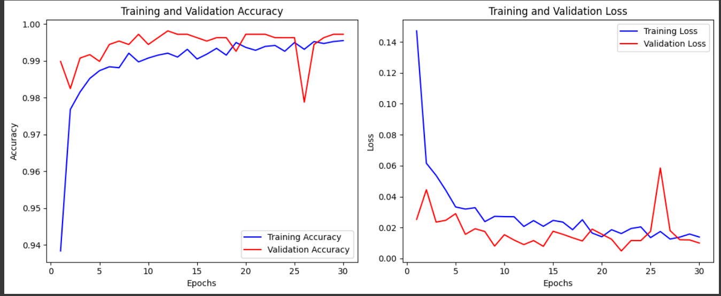
PROJECT EXHIBITION – 01
SUPERVISED BY: DR SUBASH CHANDRA BOSE I REVIEWED BY: DR NILAMADHAB MISHRA , DR SHIV SHANKAR PRASAD SHUKLA

Slide 21
1
2
3
Convergence Achieved
High Model Performance
No Significant Overfitting
Both accuracy and loss stabilize by the end of the training, indicating that the model has reached an optimal state and further training may not improve performance significantly.
The training and validation accuracy curves converge and reach close to 99%, indicating that the model performs very well on both training and validation data, with minimal performance gap
The training and validation loss curves decrease steadily and remain close to each other throughout the training process, suggesting that the model generalizes well without significant overfitting.
PROJECT EXHIBITION – 01
SUPERVISED BY: DR SUBASH CHANDRA BOSE I REVIEWED BY: DR NILAMADHAB MISHRA , DR SHIV SHANKAR PRASAD SHUKLA

Slide 22

Xception
Model
analysis
PROJECT EXHIBITION – 01
SUPERVISED BY: DR SUBASH CHANDRA BOSE I REVIEWED BY: DR NILAMADHAB MISHRA , DR SHIV SHANKAR PRASAD SHUKLA

Slide 23
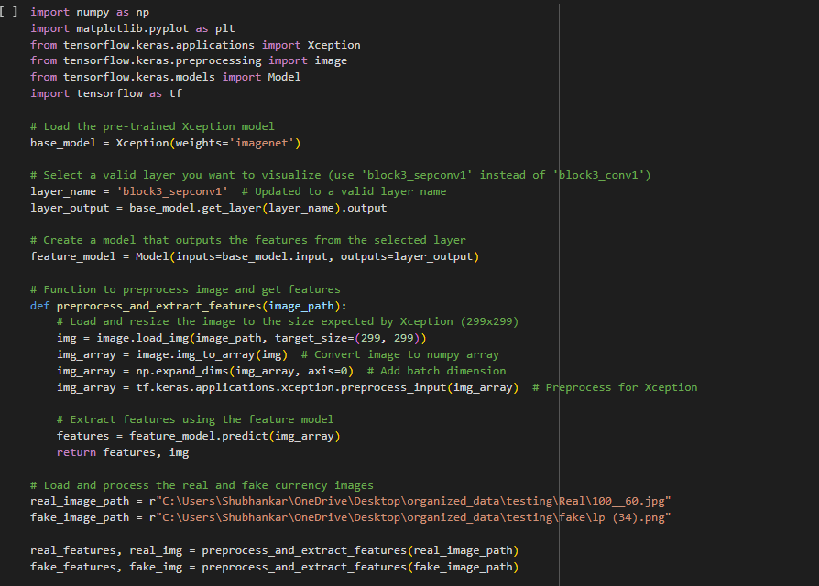
PROJECT EXHIBITION – 01
SUPERVISED BY: DR SUBASH CHANDRA BOSE I REVIEWED BY: DR NILAMADHAB MISHRA , DR SHIV SHANKAR PRASAD SHUKLA

Slide 24
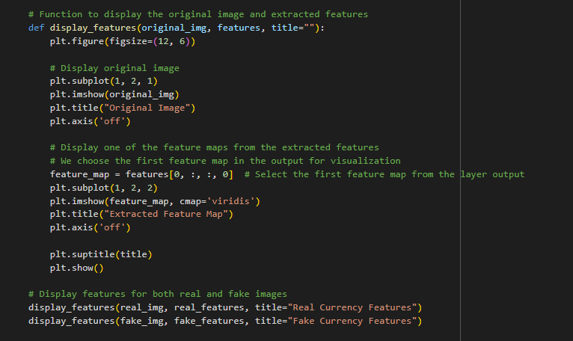
PROJECT EXHIBITION – 01
SUPERVISED BY: DR SUBASH CHANDRA BOSE I REVIEWED BY: DR NILAMADHAB MISHRA , DR SHIV SHANKAR PRASAD SHUKLA

Slide 25
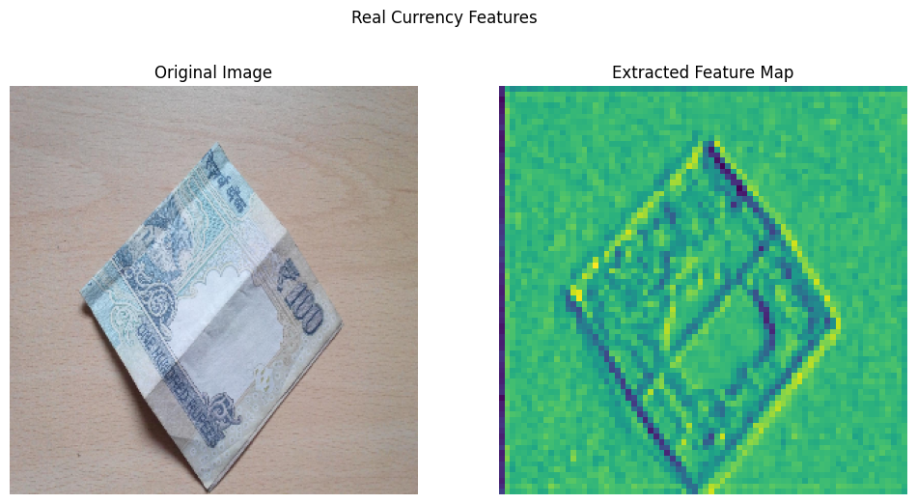
PROJECT EXHIBITION – 01
SUPERVISED BY: DR SUBASH CHANDRA BOSE I REVIEWED BY: DR NILAMADHAB MISHRA , DR SHIV SHANKAR PRASAD SHUKLA

Slide 26
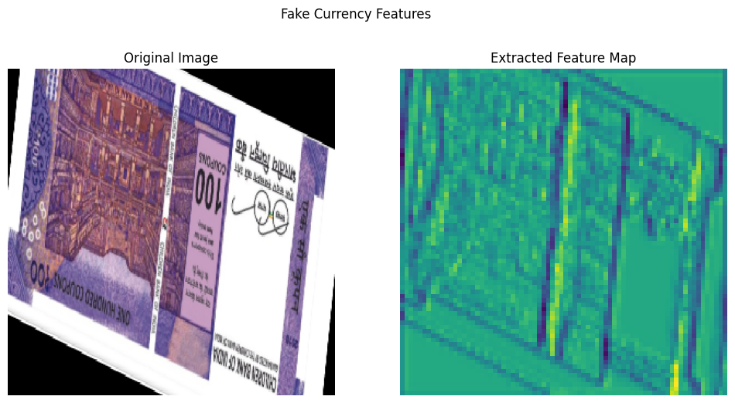
PROJECT EXHIBITION – 01
SUPERVISED BY: DR SUBASH CHANDRA BOSE I REVIEWED BY: DR NILAMADHAB MISHRA , DR SHIV SHANKAR PRASAD SHUKLA

Slide 27
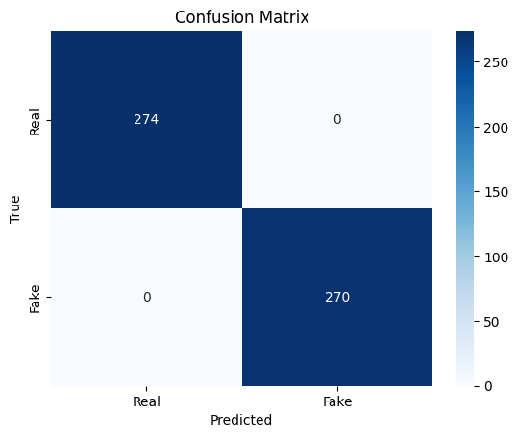
Confusion Matrix Analysis
The confusion matrix presented indicates perfect model performance for binary classification (Real vs. Fake). Here’s the detailed analysis:
True Positives (Real correctly classified): 274
The model successfully identified all 274 "Real" samples.
True Negatives (Fake correctly classified): 270
All 270 "Fake" samples were correctly predicted.
False Positives (Incorrectly classified as Fake): 0
No Real samples were misclassified as Fake.
False Negatives (Incorrectly classified as Real): 0
No Fake samples were misclassified as Real.
Key Observations:
The confusion matrix demonstrates 100% accuracy with no misclassifications.
Both classes, Real and Fake, were perfectly identified by the model.
This exceptional performance suggests the model has learned the distinguishing features between Real and Fake data very effectively.
PROJECT EXHIBITION – 01
SUPERVISED BY: DR SUBASH CHANDRA BOSE I REVIEWED BY: DR NILAMADHAB MISHRA , DR SHIV SHANKAR PRASAD SHUKLA

Slide 28
ESP32
Camera
analysis
PROJECT EXHIBITION – 01
SUPERVISED BY: DR SUBASH CHANDRA BOSE I REVIEWED BY: DR NILAMADHAB MISHRA , DR SHIV SHANKAR PRASAD SHUKLA

Slide 29
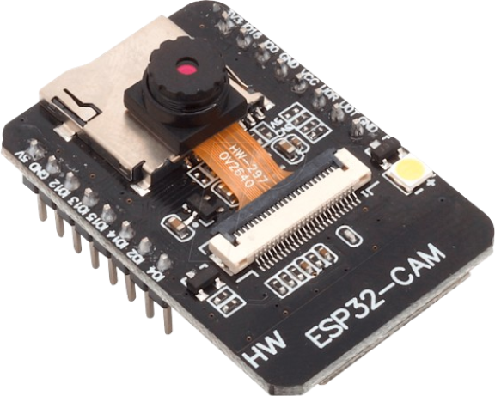
The ESP32-CAM can be used in projects aimed at detecting fake Indian currency by leveraging its camera capabilities for real-time image capture and processing. By integrating the ESP32-CAM with a machine learning model, such as the Xception model used in the Fake Indian Currency Detection project, the camera can capture high-resolution images of currency notes. These images can then be processed to detect authenticity by comparing features like security marks, patterns, and watermarks. The ESP32-CAM's Wi-Fi connectivity allows the processed results to be sent to a server or mobile device for verification, aiding in counterfeit currency detection in real time.
PROJECT EXHIBITION – 01
SUPERVISED BY: DR SUBASH CHANDRA BOSE I REVIEWED BY: DR NILAMADHAB MISHRA , DR SHIV SHANKAR PRASAD SHUKLA

Slide 30
Start(Web)
Capture Image using ESP32 Camera
Predict (Real or Fake)
PROJECT EXHIBITION – 01
SUPERVISED BY: DR SUBASH CHANDRA BOSE I REVIEWED BY: DR NILAMADHAB MISHRA , DR SHIV SHANKAR PRASAD SHUKLA

Slide 31

PROJECT EXHIBITION – 01
SUPERVISED BY: DR SUBASH CHANDRA BOSE I REVIEWED BY: DR NILAMADHAB MISHRA , DR SHIV SHANKAR PRASAD SHUKLA

Slide 32




PROJECT EXHIBITION – 01
SUPERVISED BY: DR SUBASH CHANDRA BOSE I REVIEWED BY: DR NILAMADHAB MISHRA , DR SHIV SHANKAR PRASAD SHUKLA

Slide 33

PROJECT EXHIBITION – 01
SUPERVISED BY: DR SUBASH CHANDRA BOSE I REVIEWED BY: DR NILAMADHAB MISHRA , DR SHIV SHANKAR PRASAD SHUKLA

